Slide 1
Office Solutions Development
Topic 8:
Using Macros in Microsoft Excel - Part 1
Notes:
NCC Education - Title Master

Slide 2
Scope and Coverage
This topic will cover:
  How macros can be used in Microsoft Excel and how to create and execute them
Notes:
NCC Education - Slide Master

Slide 3
Learning Outcomes
By the end of this topic, students will be able to:
  Create, save and run a macro in Microsoft Excel
  Perform the following tasks using a macro:
    format titles, formulas and tables
    input dates and times
    input and select data
    design interactive forms

Slide 4
Terminology
  Terminology will be explained in the lecture, tutorial and laboratory session. You should take notes!
  Ask questions if you do not understand.

Slide 5
Uses of Macros in Microsoft Excel
  Macros can be used in Excel to automate tasks, such as:
    Data entry and validation
    Data selection
    Interactive user forms
    Formatting features and functions
    Data output
    Navigation

Slide 6
Creating a Macro
  Plan your macro - you should plan the steps that you want a macro to perform before you record or write it (remember the importance of planning was discussed in Topic 2, Slide 18).
  A macro that is used often can be assigned to shortcut keys, buttons, pictures or icons, without having to open the Macro dialogue box.
  A macro can be created by either recording it using the Macro recorder or writing VBA code in the VB Editor. Each development method will be used in this Topic and in Topic 9.

Slide 7
Overview of Recording a Macro
  The macro recorder is turned on.
  A name for the macro is entered, it is assigned to a short cut key (optional), it is saved and a description is given to it (optional).
  The recorder is started.
  Steps for the macro are entered.
  The recorder is stopped.

Slide 8
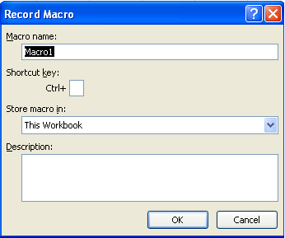
Turning on the Macro Recorder
  Select the Macro option.
  The Record Macro dialogue box is displayed and here you can:
  - name your macro
  - assign your macro to short
  cut keys
  - save your macro
  - describe your macro

Slide 9
Naming a Macro
  The name must begin with a letter.
  It must not contain spaces.
  The underscore must be used to separate words.

Slide 10
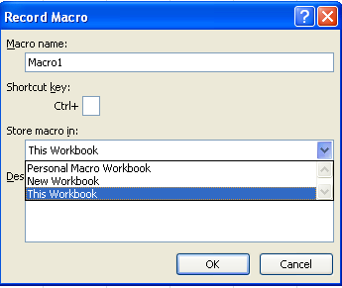
Saving a Macro
  When a macro is created, it can be saved in one of the following places:
  - This Workbook (the macro will only be available in the spreadsheet in which it was created
  - Personal Macro Book (the macro will be available to all spreadsheets)
  - New Workbook (the macro
  will only be available in that
  spreadsheet)

Slide 11
Starting to Record a Macro
  Once you have began to record your macro, perform each action that you want to include in the macro.
  Note that the mouse can be used to click on commands and option, but the macro recorder cannot record mouse actions. To move the insertion point or select, copy, or move text, you must use keyboard commands.
  To stop recording your macro at any click on the stop macro button on the bottom left corner of the screen.

Slide 12
Running a Macro
  If the macro has been assigned to a key combination, that key combination can be pressed to run the macro.
  Or, select the macro from the macro list and then select Run.

Slide 13
Formatting Titles and Formulas - 1
  How to prepare a spreadsheet each month with the same titles, formatting and formulas:
    When you want to create a new spreadsheet, you usually open the previous month’s spreadsheet, delete the figures and save it as the current month’s spreadsheet.
    If you create a template spreadsheet that contains a macro that automates the titles, formatting and formulas, you can open a new spreadsheet, run the macro and then all you will have to do is enter the current month’s figures.

Slide 14
Formatting Titles and Formulas - 2
  Open a new spreadsheet.
  Open the macro dialogue box.
  Enter MonthlyFinancialReport for the name of the macro.
  Save it in the Personal Macro Workbook.
  Enter a description.
  Click OK.

Slide 15
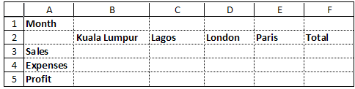
Formatting Titles and Formulas - 3
  The following data is entered into the spreadsheet:
  Each heading is in bold.
  In cell B5, the formula =SUM(A4-A3) is entered.
  The contents of cell B5 are copied to cells C5 and D5.

Slide 16
Formatting Titles and Formulas - 4
  In cell F3 the formula =SUM(B3:E3) is entered.
  In cell F4 the formula =SUM(B4:E4) is entered.
  In cell F5 the formula =SUM(B5:E5) is entered.
  The macro recorder is turned off.
  Data is then entered into the worksheet to test that the formulas work.
  The macro is tested by opening a new spreadsheet (or worksheet) and running the macro to display the template.

Slide 17
Format a Table
  How to format a table (formatting colour, font and border styles):
    Open a spreadsheet that either contains a table or create one.
    Open the macro dialogue box and enter the required data.
    Click OK.
    Format the table.
    Stop the recording the macro.
    Test the macro.

Slide 18
Dates and Times - 1
  Click in the cell in which you want the date to appear.
  Open the Record Macro dialogue box.
  Enter the macro name, etc., Click OK
  In the cell enter =TODAY()
  Right click and choose format cells.
  Select Month date year as the format, click OK.
  Stop recording.

Slide 19
Dates and Times - 2
  If you do not want the current date to be displayed on the spreadsheets, but want it to remain static:
    Create the macro up until the step, ‘Select Month date year as the format, click OK’.
    Select Copy > Paste > Paste Values (the value in the Formula bar changes from TODAY() to the actual date)
    Press ESC.
    Stop recording.
    Test the macro.

Slide 20
Data Entry - 1
  In Topic 6 you wrote macros in the VB Editor that displayed simple message boxes conveying information to a user, allowing them to click on OK but not enabling interaction. We will now create simple interactive macros.
  The following is a macro that displays an input box which requests a user to enter their name; when a user enters their name, it is displayed on the spreadsheet.
  VBA will be used to write the macro in the VB Editor.

Slide 21
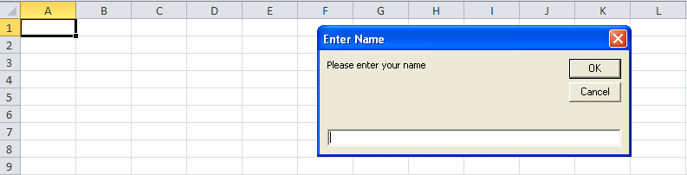
Data Entry - 2
    Sub EnterName()
    Dim strName As String
    strName = InputBox("Please enter your name", "Enter Name")
    Range("A1").Select
    ActiveCell.FormulaR1C1 = strName
    End Sub

Slide 22
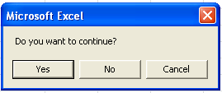
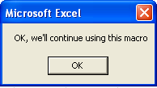
Message Boxes and Feedback
  The message box below provides feedback to a user depending on which button is selected.
  The macro has been written so that if YES is selected, another message box is then displayed.

Slide 23
Message Box Code
  The code for the previous message box is as follows:
  Sub Message()
  x = MsgBox("Do you want to continue?", 3)
  If x = 7 Then Exit Sub
  MsgBox ("OK, we'll continue using this macro")
  End Sub

Slide 24
Explanation of Message Box Code
  These two lines of code need explaining:
  x = MsgBox("Do you want to continue?", 3)
  If x = 7 Then Exit Sub
  The 3 refers to a display of optional buttons that can be displayed in a message box. There are five combinations of buttons that can be displayed, as can be seen on the next slide:

Slide 25
Message Box Buttons
Name | Value | Description
vbOKCancel | 1 | Displays OK and Cancel buttons
vbAbortRetryIgnore | 2 | Displays Abort, Retry and Ignore buttons
vbYesNoCancel | 3 | Displays Yes, No and Cancel buttons
vbYesNo | 4 | Displays Yes and No buttons
vbRetryCancel | 5 | Displays Retry and Cancel buttons

Slide 26
Further Explanation
  The following line of code needs to be explained:
  If x = 7 Then Exit Sub
  When the user clicks on a button, an action occurs depending on what value has been assigned to the button
  x contains the value 7, which means that when the No button is clicked, the message box will no longer be displayed – this value can be seen in with other values on the following slide:

Slide 27
Values Assigned to Buttons
Name | Value | Description
vbOK | 1 | Ok
VbCancel | 2 | Cancel
vbAbort | 3 | Abort
vbRetry | 4 | Retry
vbIgnore | 5 | Ignore
vbYes | 6 | Yes
vbNo | 7 | No

Slide 28
References - 1
  Gonzalez, J., Meister, C., Ozgur, S., Dilworth, B., Troy, A. and Brandt, T. (2006). Office VBA Macros You Can Use Today: Over 100 Amazing Ways to Automate Word, Excel, PowerPoint, Outlook & Access, Holy Macroi Press.
  Microsoft Office: Macros and Security. (2011). http://www.msoffice-tutorial.com/macro-security.php

Slide 29
References - 2
  Visual Basic/Getting Started. (2010). [Available Online]
  http://en.wikibooks.org/wiki/Visual_Basic/Getting_Started
  VBScript Glossary. (1997). [Available Online]
  http://tinyurl.com/69kxbe5

Slide 30
Topic 8 – Using Macros in Microsoft Excel Part 1
Any Questions?
Notes:
NCC Education - End Slide Master

